Slide 1

AI-Enhanced Voice Recognition System for Arduino LED Control
MLA0101- Artificial intelligence And Expert Systems
Supervisor
Dr. P. Subramanian
Dept. of CSE
Mokshitha Kilari(192525413)
Chandana K(192525363)
Juhi Surin(192525148)

Slide 2
INTRODUCTION
TVoice-controlled technology is becoming increasingly useful in smart home automation.
his project combines AI voice recognition with Arduino Uno.
The user speaks a command through a microphone or smartphone.
The AI system recognizes the command.
The command is transmitted to Arduino through Bluetooth.
Arduino controls the Red, Green and Blue LEDs based on the command.
Notes:
Good morning everyone.
Today we are going to present our project titled AI-Enhanced Voice Recognition System for Arduino LED Control.
This project combines Artificial Intelligence, voice recognition, Bluetooth and Arduino to control LEDs using voice commands.
Voice-controlled technology is becoming increasingly useful in smart home automation.
Our project combines AI voice recognition with Arduino Uno.
The user gives a voice command through a microphone or smartphone.
The AI system recognizes the command and sends it to Arduino through Bluetooth.
Based on the command, Arduino controls the Red, Green and Blue LEDs.
So basically, we can control the LEDs without manually pressing a switch

Slide 3
PROBLEM STATEMENT
Traditional LED systems require manual switches for operation.
Manual control is inconvenient for some users.
Conventional systems do not provide intelligent voice interaction.
There is a need for a simple and affordable voice-controlled automation system.
The proposed system uses AI-based voice recognition to control LEDs through spoken commands.

Slide 4
OBJECTIVES
To develop a voice-controlled LED system using AI.
To recognize spoken commands accurately.
To transmit commands wirelessly to Arduino.
To control LEDs in real time.
To provide a hands-free and user-friendly system.
To create a low-cost solution that can be extended to other smart devices.

Slide 5
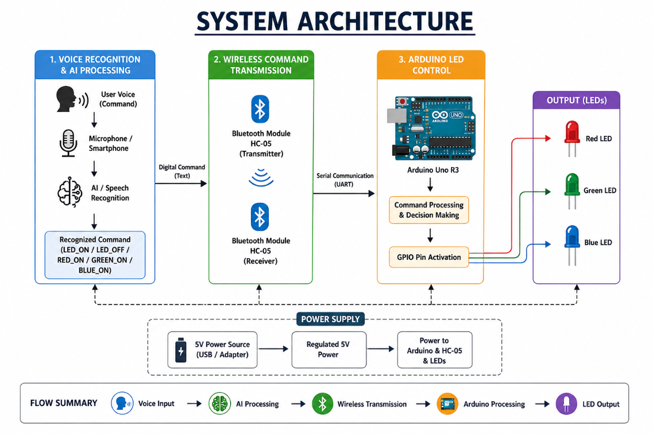
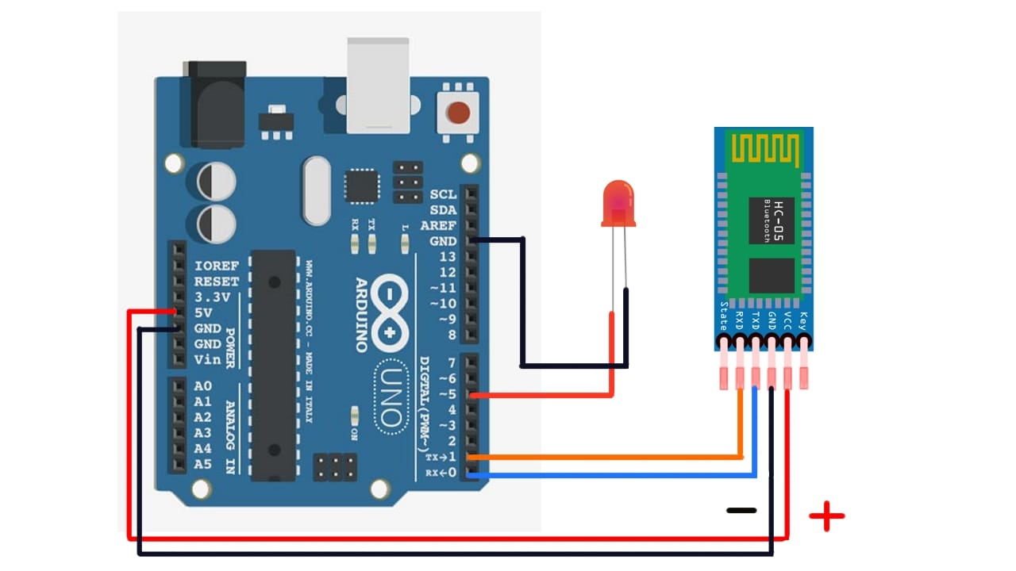
SYSTEM ARCHITECTURE

Slide 6
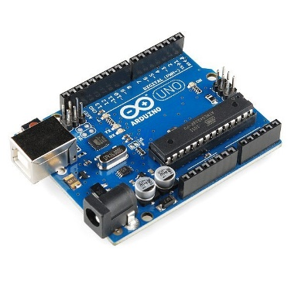
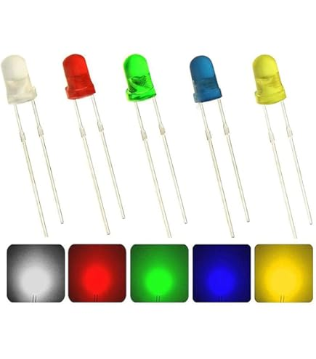
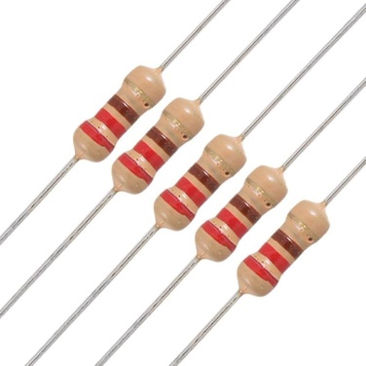
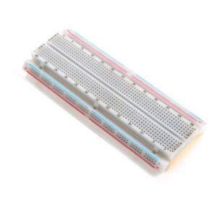
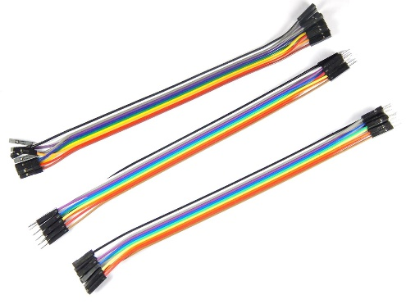
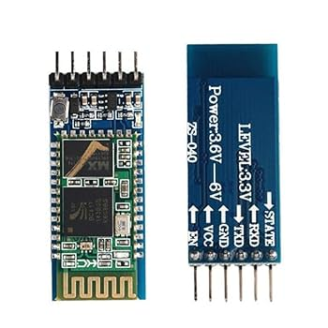
COMPONENTS
Arduino Uno R3
Led( Red green blue ) 1pc
Resistor 220ohm-3pcs
Breadboard
Jumper wire
Bluetooth module HC-05

Slide 7
DATASET
Voice Command | Arduino Action
Turn ON LED | LED ON
Turn OFF LED | LED OFF
Red LED ON | Red LED ON
Green LED ON | Green LED ON
Blue LED ON | Blue LED ON

Slide 8
MODULE 1: VOICE RECOGNITION & AI PROCESSING
Purpose: Convert human speech into a recognizable command.
Working
User speaks a voice command.
Microphone/smartphone captures the voice.
Speech recognition processes the input.
AI identifies the intended command.
The recognized command is prepared for transmission.
Example
“Turn ON LED” → AI recognizes LED_ON

Slide 9
MODULE 2: WIRELESS COMMAND TRANSMISSION
Purpose: Transfer the recognized command from the AI system to Arduino.
Working
AI generates the recognized command.
The command is sent to the Bluetooth HC-05 module.
HC-05 transmits the command wirelessly.
Arduino receives the command through its communication interface.
Technology
Smartphone / PC → Bluetooth HC-05 → Arduino

Slide 10
MODULE 3: ARDUINO LED CONTROL
Purpose: Execute the received command and control the LEDs.
Working
Arduino receives the Bluetooth command.
The command is compared with predefined actions.
Arduino activates the required GPIO pin.
The corresponding LED turns ON/OFF.
The result is displayed through the LED.
Example
LED_ON → Arduino → GPIO HIGH → LED ON

Slide 11
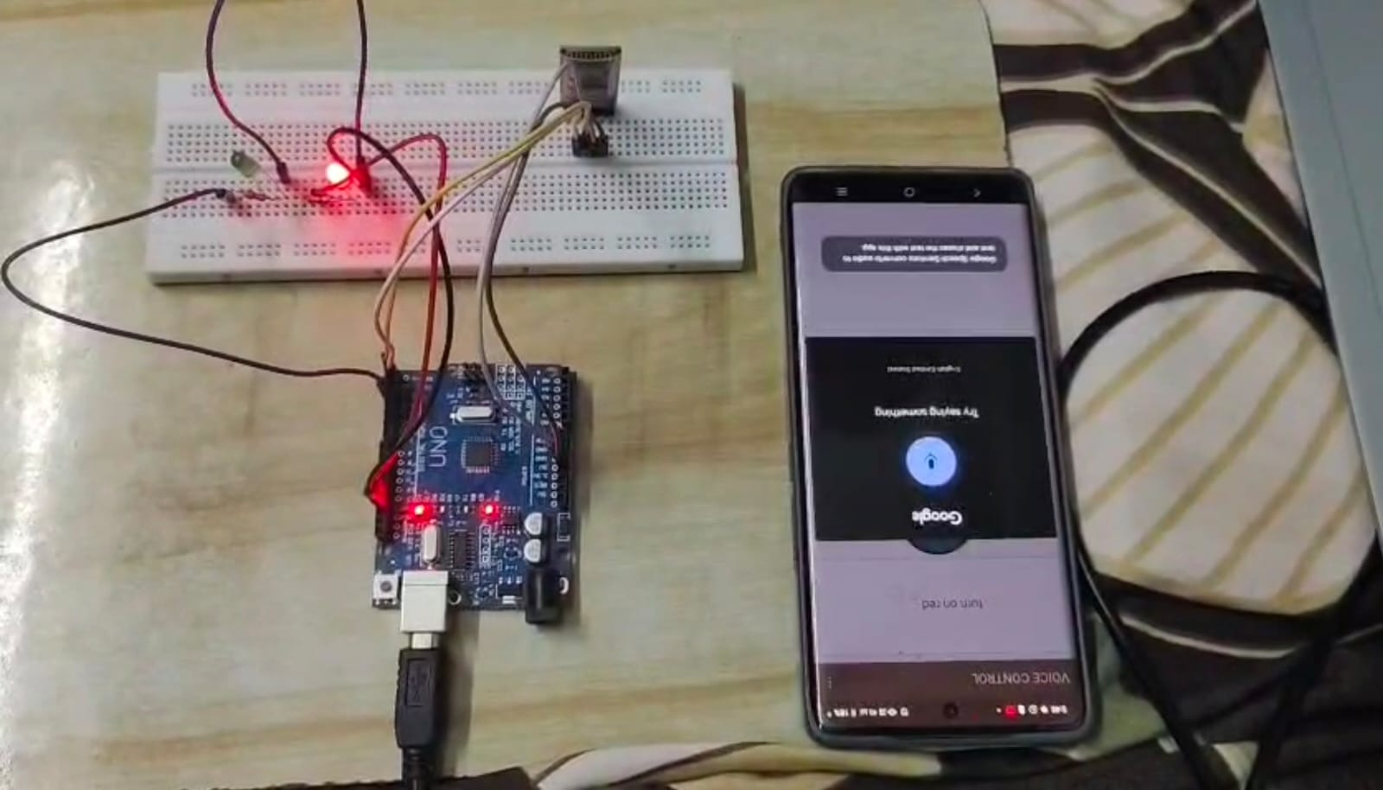
OUTPUT
Successful Control: Arduino-connected LED operated through voice commands.
Accurate Recognition: Commands like “turn on” and “turn off” detected correctly.
Fast Response: Minimal delay in execution.
Quiet Environment: High reliability and quick response.
Background Noise: Moderate noise slightly reduced accuracy.
Overall Outcome: AI integration improved efficiency and user-friendliness of voice-based hardware control.

Slide 12
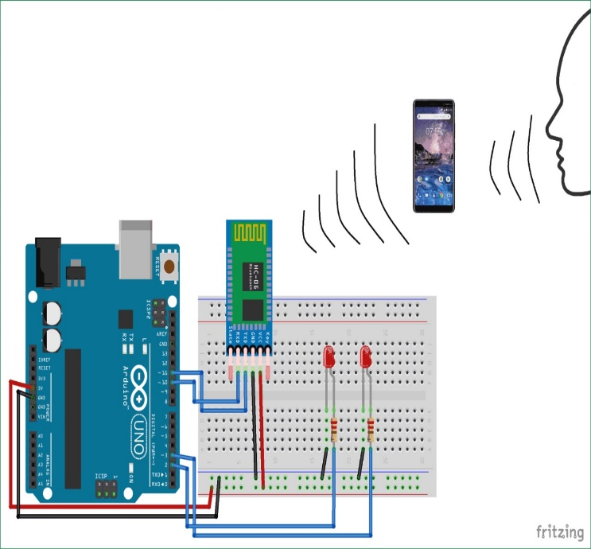
CONCLUSIONS
CONCLUSION
AI-Enhanced Voice Recognition enables real-time device control using speech.
Arduino Uno + Bluetooth integration provides a simple and effective setup.
Hands-free, fast, and convenient operation of LED lights.
Eliminates the need for physical switches.
Suitable for smart homes, automation projects, and mobility assistance.
Provides an affordable and practical path to home automation

Slide 13
REFERENCES
Patel, Parth, Nikhil Gupta, and Sachin Gajjar. "Real time voice recognition system using tiny ml on arduino nano 33 ble." 2025 IEEE International Symposium on Smart Electronic Systems (iSES). IEEE, 2025.
Rahaman, T. U., Dutta, K., & Kar, S. (2026, April). AI-Powered Offline Home Automation Framework Using Arduino and Local Voice Recognition. In 2026 International Conference on Emerging Research in Smart Electronics and Machine Informatics (ECMI) (pp. 1-10). IEEE.
Ramya, R. S. (2026). AI-Assisted Voice Controlled Prosthetic Arm using High-Performance Embedded Microcontroller. International Journal of Engineering & Extended Technologies Research (IJEETR), 8(2), 3587-3593.
Hariri, M. (2025). LED Control System Using Arduino Wemos D1 R1 Based on Web Server Communication Via Internet of Things (IoT). Formosa Journal of Science and Technology.
Patel, P., Gupta, N., & Gajjar, S. (2024, December). Real time voice recognition system using tiny ml on arduino nano 33 ble. In 2024 IEEE International Symposium on Smart Electronic Systems (iSES) (pp. 385-388). IEEE.

Slide 14


